Slide 1

Customer Shopping Behavior Analysis
Analyzing 3,900 purchases to uncover insights into spending patterns, customer segments, and product preferences that drive strategic business decisions.

Slide 2
Dataset Overview
3,900
18
50
25
Total Purchases
Data Features
Locations
Products
Transactions analyzed across all categories
Comprehensive customer and purchase attributes
Geographic diversity in customer base
Unique items across four categories
Customer Demographics
Shopping Behavior
Age, Gender, Location
Discounts & Promo Codes
Subscription Status
Review Ratings
Purchase History
Shipping Preferences

Slide 3

Data Preparation & Cleaning
01
Data Loading & Exploration
Imported dataset using pandas and performed initial structure analysis with df.info() and .describe()
02
Missing Data Handling
Imputed 37 missing Review Rating values using median rating by product category
03
Feature Engineering
Created age_group bins and purchase_frequency_days columns for deeper analysis
04
Database Integration
Connected to PostgreSQL and loaded cleaned data for SQL analysis

Slide 4
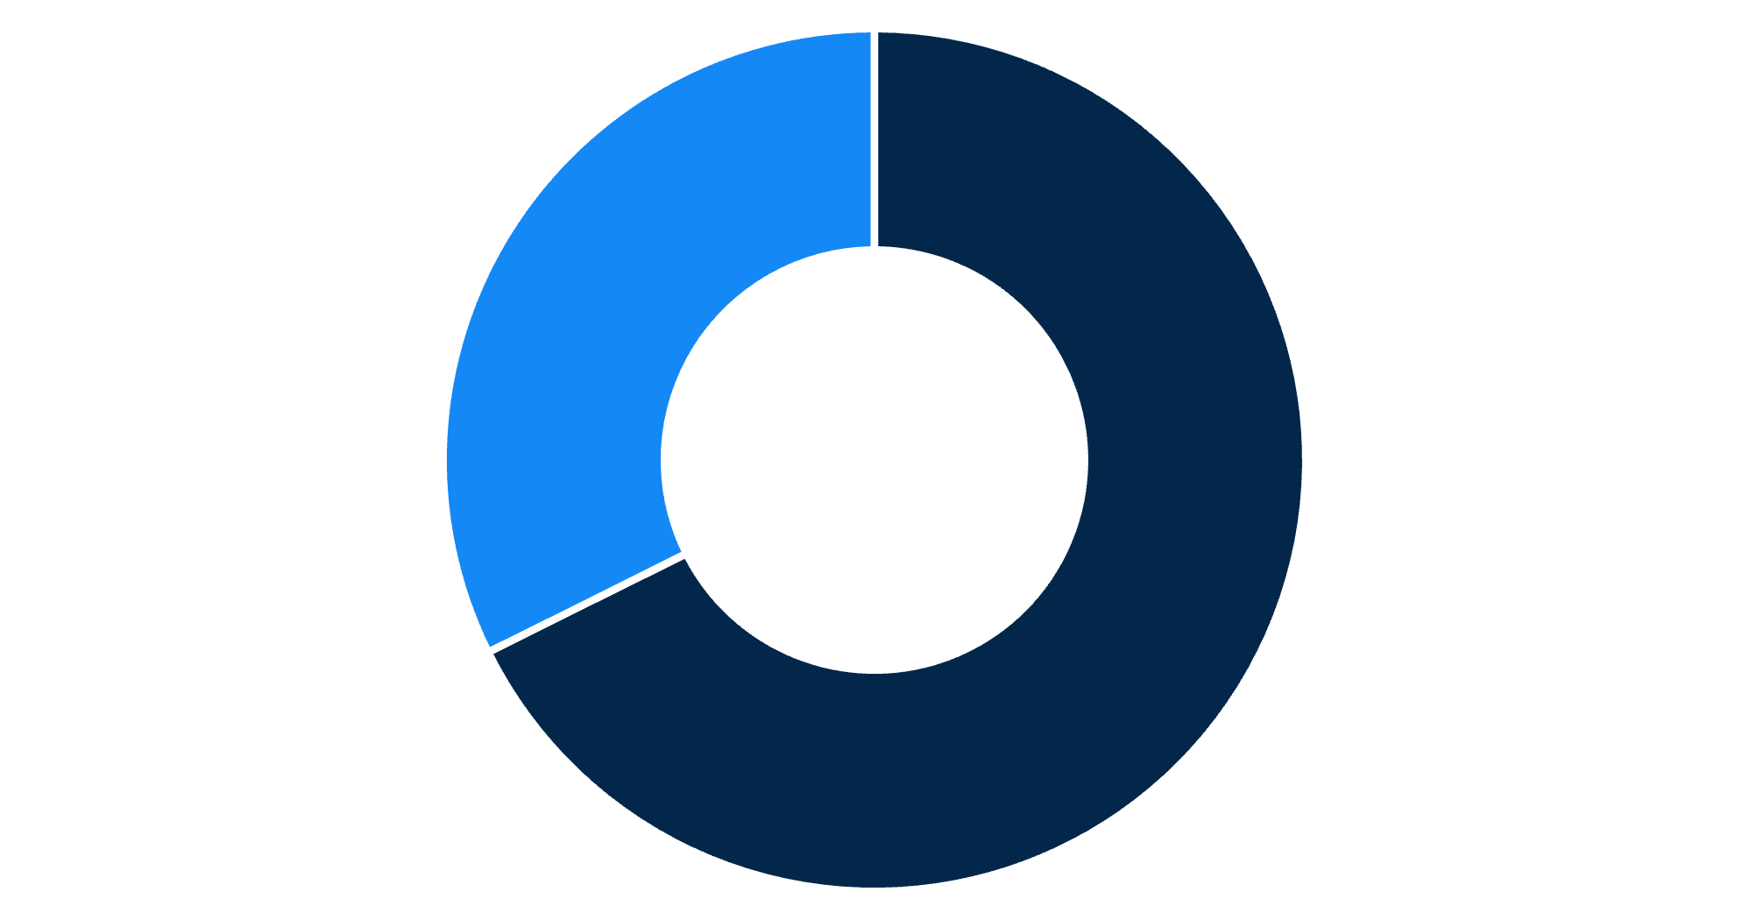
Revenue by Gender
Male Customers Drive Revenue
Male customers generated $157,890 in total revenue compared to $75,191 from female customers, representing 68% of total sales.
Male
Female

Slide 5

Customer Segmentation Insights
Loyal Customers
Returning Buyers
3,116 customers
701 customers
Largest segment with consistent purchase history
Growing segment showing repeat engagement
New Customers
83 customers
Smallest segment with conversion potential
Customer classification based on purchase history reveals strong loyalty base, with 80% of customers in the Loyal segment.

Slide 6
Top-Rated Products
1
2
3
Gloves
Sandals
Boots
Average Rating: 3.86
Average Rating: 3.84
Average Rating: 3.82
4
5
Hat
Skirt
Average Rating: 3.80
Average Rating: 3.78
These products consistently receive the highest customer satisfaction ratings and should be featured prominently in marketing campaigns.

Slide 7


Shipping & Subscription Analysis
Shipping Type Comparison
Subscription Impact
27%
Subscribers
60.48
1,053 customers generating $62,645
73%
Non-Subscribers
2,847 customers generating $170,436
Express
Similar average spend across both groups.
Average purchase amount
58.46
Standard
Average purchase amount
Express shipping customers spend slightly more per transaction.

Slide 8

Discount Strategy Analysis
High-Value Discount Users
Top Discounted Products
839 customers used discounts but still spent above the $59.76 average purchase amount, demonstrating that strategic discounting doesn't always reduce transaction value.
Hat (50% discount rate)
Sneakers (49.66%)
Coat (49.07%)
Sweater (48.17%)
Pants (47.37%)

Slide 9
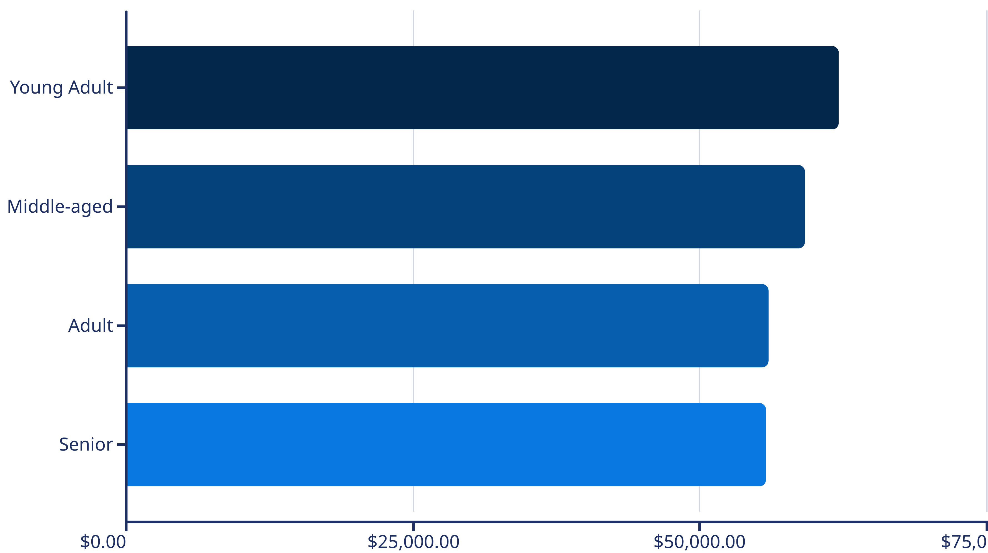
Revenue by Age Group
Young Adults contribute the highest revenue at $62,143, followed closely by Middle-aged customers. Revenue distribution is relatively balanced across all age segments.

Slide 10

Strategic Recommendations
Boost Subscriptions
Loyalty Programs
Optimize Discounts
Promote exclusive benefits and rewards to convert the 73% non-subscriber base
Reward repeat buyers to strengthen the 3,116-customer loyal segment
Balance promotional sales with margin control for sustainable growth
Feature Top Products
Targeted Marketing
Highlight high-rated items like Gloves and Sandals in marketing campaigns
Focus on Young Adults and express-shipping users for maximum ROI

